Slide 1
LEVEL 4/5 GROUP 10
THOMAS MCLAREN
JAMIE OWERS
EDUARD IABLONSCHI
EDWARD PHILLIPS

Slide 2
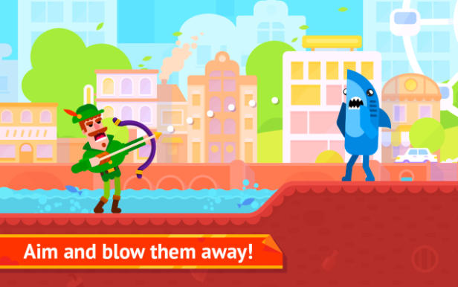
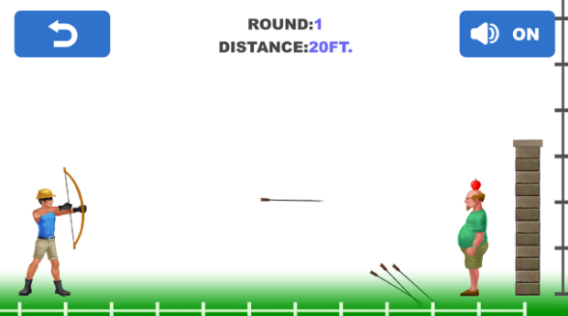
Genre/ Style
2D Action game
Mobile only
Competitive 2 player
Notes:
Tom McLaren slide

Slide 3
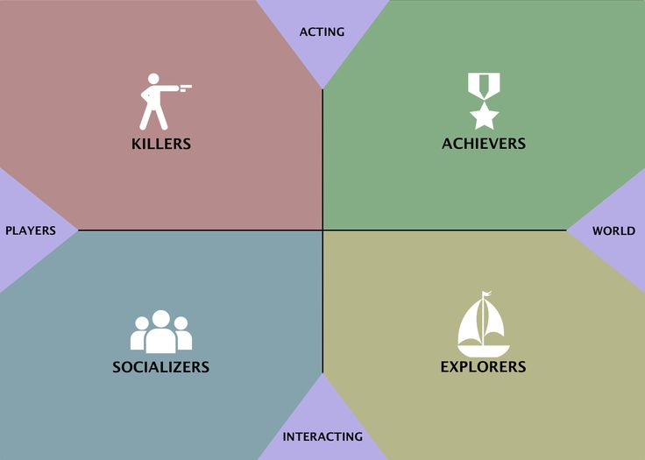
Target Demographic
Socializers
+ Killers
Age:
12+
Gender:
Males & females
Notes:
Jamie Owers Slide

Slide 4
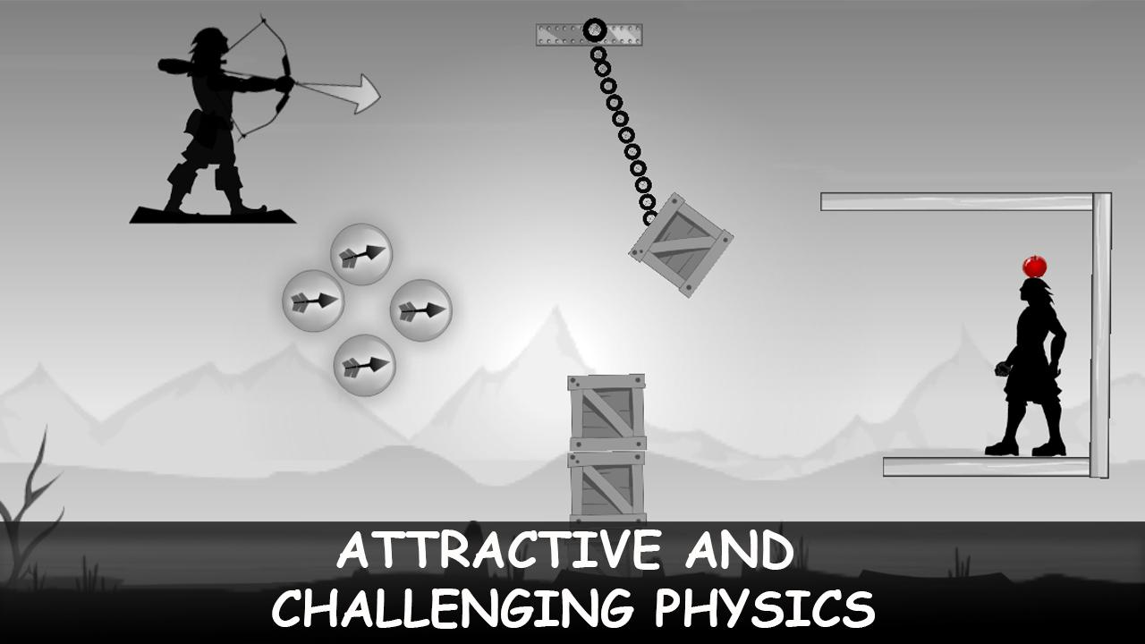
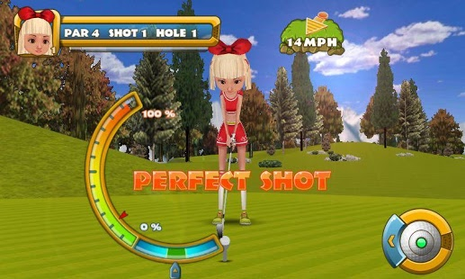
Mechanics
Symmetric mechanic – Aiming & power selection
Damage – (hit by projectile)
Health bar
Notes:
Eduard Iablonschi Slide

Slide 5
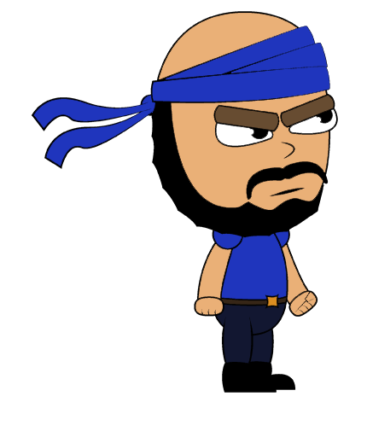
What does the player do?
Button press
Competitive - goal
Reflex - selecting trajectory & power
Fiero
Notes:
Tom McLaren Slide

Slide 6
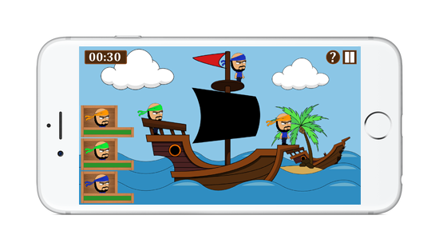
What the player sees

Slide 7



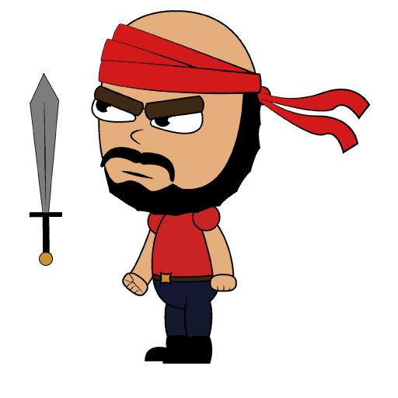


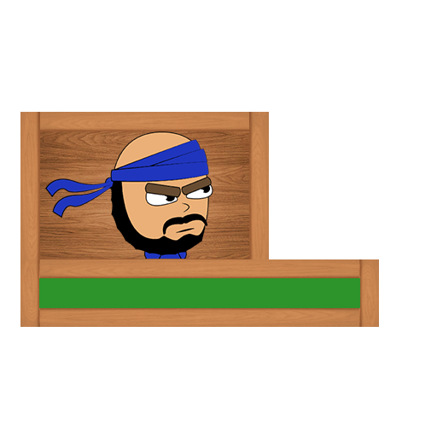
Art Style
Notes:
Edward Phillips Slide

Slide 8
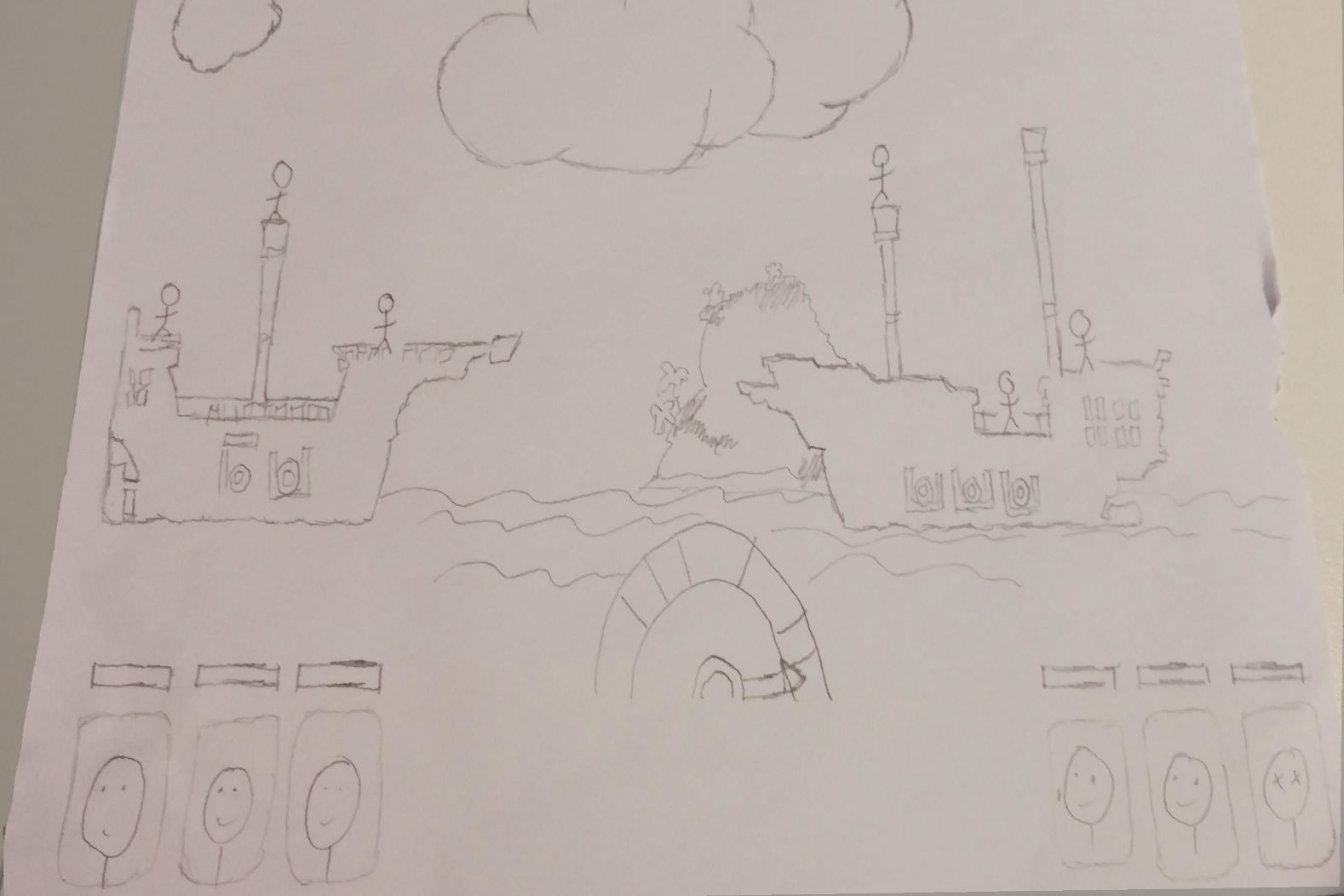
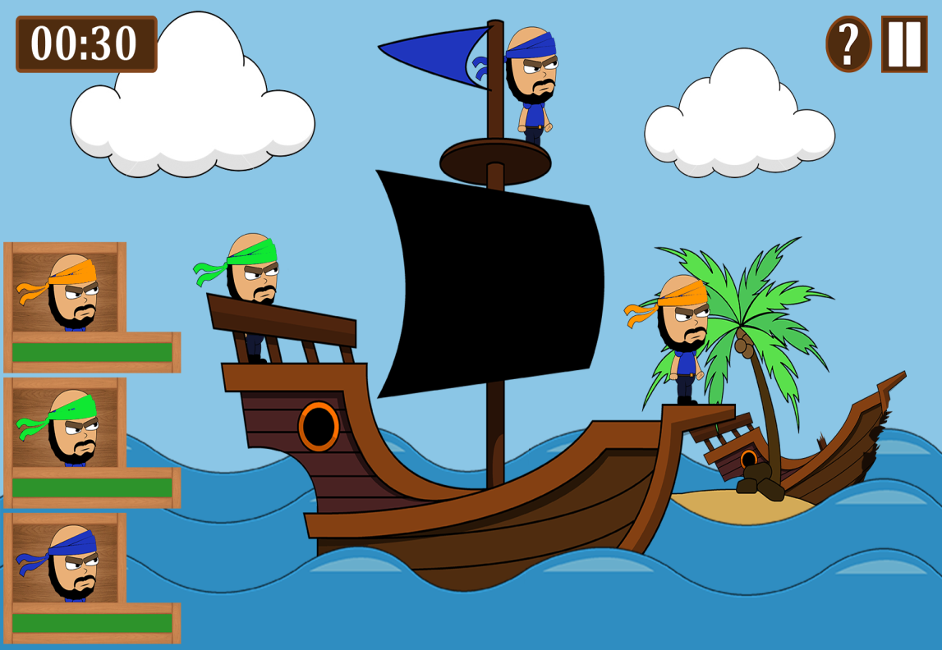
How has the game been iterated?

Slide 9
Current Game

Slide 10
Play Testing (first experience)
Positives
Instantly grasped the games mechanics and end goal
Fiero experienced both when hitting an opponent and taking damage
Negatives
Players didn’t automatically always realise you tap to shoot and aim
Gameplay gets repetitive
Notes:
Talk about this is the feedback from players after their initial first experience player our game. They had no instructions or where told what the game was at all.

Slide 11

Planned iterations
Animation during the control screen, which shows players that you need to tap to aim and shoot
Add additional projectiles available for the players to throw
Notes:
Mention that these are in order to combat the previous negative experiences players have shared after our latest batch of play testing.
Make sure to say that the control screen animation will combat the issue of players not automatically realising that you have to tap to aim and shoot.
Make sure to say that the extra projectiles have already been made in art form, however just need to be implemented into the game. This will then combat the issue of players finding the game tedious and repetitive.

Slide 12

Targets for final pitch
Have the planned iterations completed
Make sure characters are animated
Insure there are no bugs causing freezing or slow downs during gameplay
Notes:
Mention the slow down issue seems to occur when animations are implemented into the game. Also that the animations for characters have been produced in art form. However they just need to be implemented without any drop in frame rates during gameplay, which effects the player experience.

Slide 13

ANY QUESTIONS?

